Slide 1
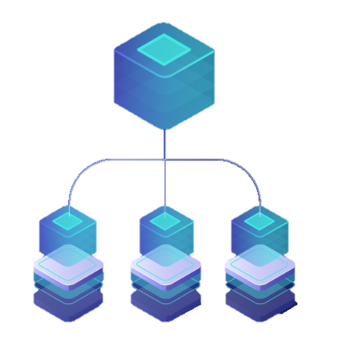
Microservice
Architecture
DATE
1st July 2021

Slide 2
Microservices
API

Slide 3
What are Microservices?
It is an architectural style that structures an application as a collection of services that are
Highly maintainable and testable
Loosely coupled
Independently deployable
Organized around business capabilities
Advantage:
The microservice architecture enables the rapid, frequent and reliable delivery of large, complex application as a collection of small autonomous services, modeled around a business domain.

Slide 4

Monolithic
Architecture
Microservices
Architecture
UI
UI
Business
Logic
DAL
Microservice
Microservice
Microservice
Microservice
DATABASE
DATABASE
DATABASE
DATABASE

Slide 5
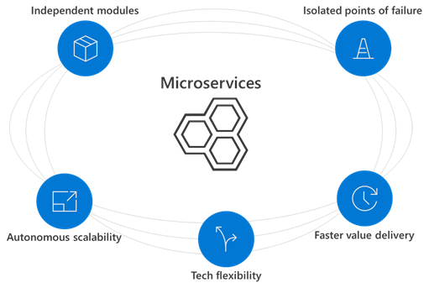

Slide 6
Some important facts about MICROSERVICES
Microservices are smaller in size
Microservices are easier to develop, deploy, and debug, because a fix only needs to be deployed onto the microservice with the bug, instead of across the board
Microservices can be scaled quickly and can be reused among different projects
Microservices work well with containers like Docker
Microservices are independent of each other, meaning that if one of the microservices goes down, there is little risk of the full application shutting down
Microservices don't need to share the same technology stack, libraries, or frameworks.

Slide 7

JACK is a Developer
Knows C# Dot Net
Knows MVC architecture
Knows Angular
Basics of Cloud computing
API
CONTAINER
IAAS
PAAS
FAAS
IAAS
PAAS
VM
App
Az-Func
Docker
AKS
SF
ACI
API Gateway
API Gateway

Slide 8

There are some “super humans” who try to learn all the possible ways to implement microservices.
Eventually most of them end up doing something like this

Slide 9
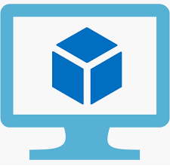


API
CONTAINER
LOGIC
LOGIC
Code
+
dep
APP/API
LOGIC
IMAGE
LOGIC
Hosting environment
Docker HOST
IMAGE
VM
App Service
Azure Function
CONTAINER

Slide 10
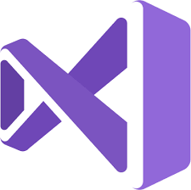
DEMO
Deploying API as a Container
1
2
3
Deploy it to
Azure CR
Develop API in
Visual Studio
Azure App service
based on IMAGE

Slide 11
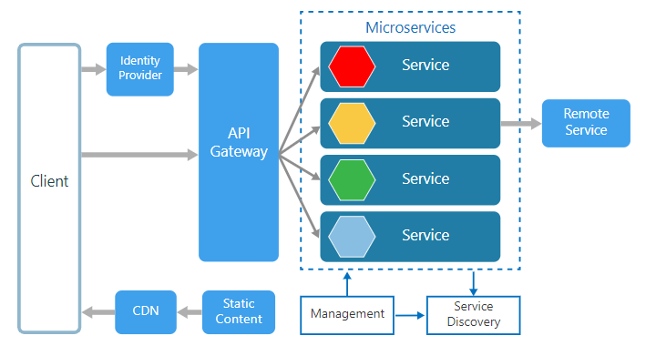
Microservices Detailed architecture

Slide 12
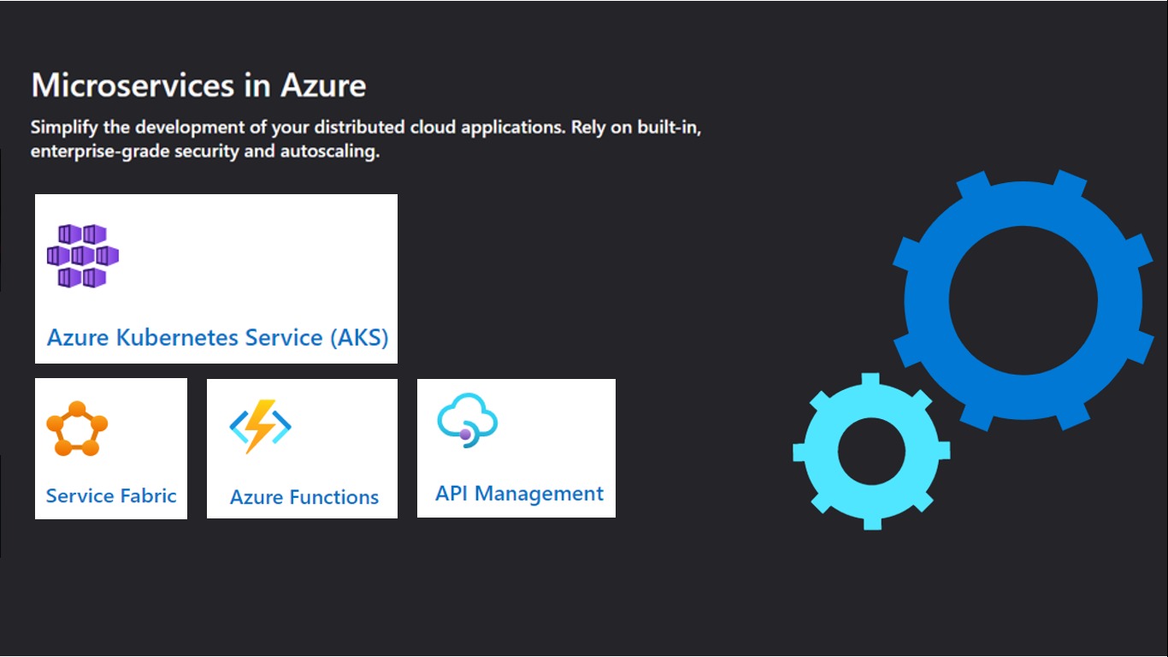

Slide 13
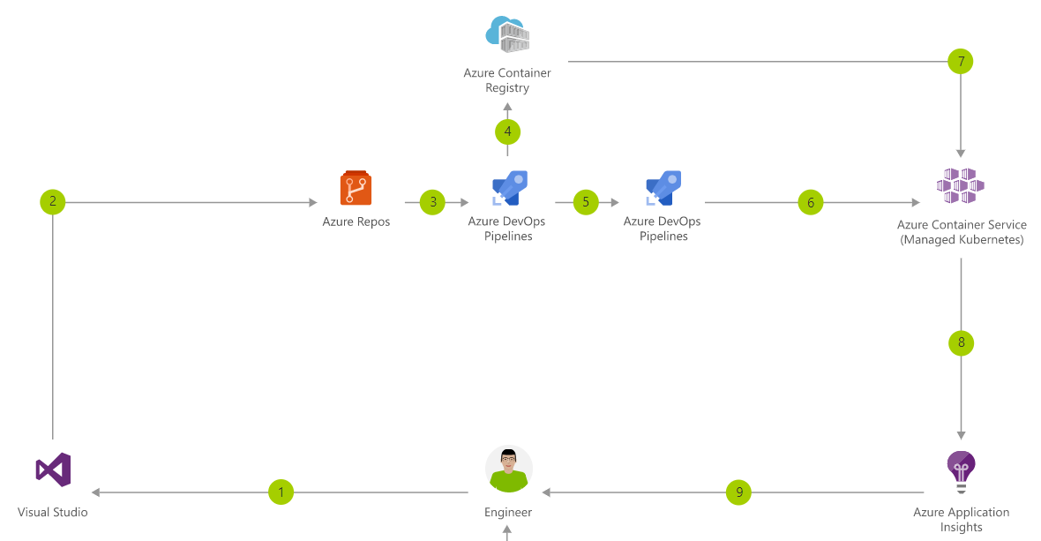

Slide 14
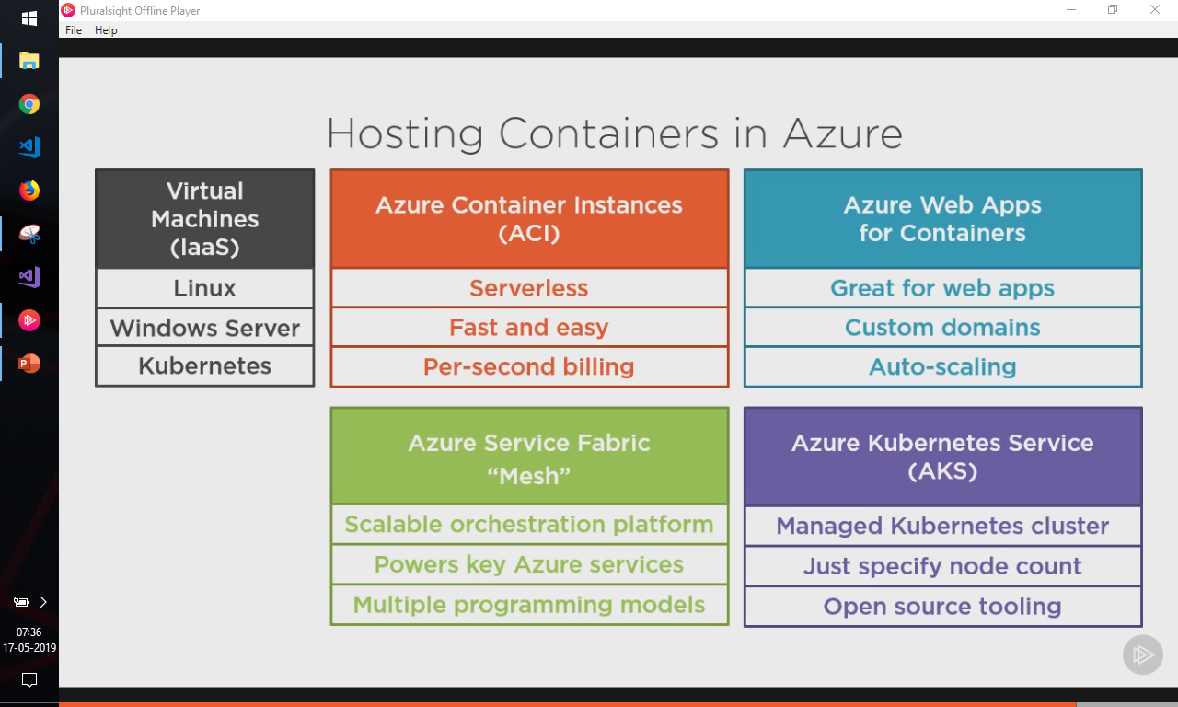

Slide 15
Azure Functions
Solution for running small pieces of code, or "functions," in the cloud
Supports a wide variety of programming languages, for instance like C#, JavaScript, Java, PHP, Python etc
Even supports scripting languages like PowerShell and Shell
Works on Serverless(consumption) model as well as app service plan and premium plan

Slide 16
Function Integrations
The following service integrations are supported by Azure Functions:
Azure Cosmos DB
Azure Event Hubs
Azure Event Grid
Azure Notification Hubs
Azure Service Bus (queues and topics)
Azure Storage (blob, queues, and tables)
On-premises (using Service Bus)

Slide 17
Azure Functions hosting
Azure Functions are designed to be portable and to be hosted in a variety of places, including:
Azure Functions service by using Resource consumption, Premium, or App Service Plans
Internet of Things (IoT) devices
On-premises by using App Service on Azure Stack
Azure services that support containerization ( AKS, ACI, SF )
Non-Azure container hosts (Kubernetes, Virtual Machines, other cloud providers)

Slide 18



Function Triggers
Execution
Service
Function app

Slide 19
Types of Triggers
HTTPTrigger - Trigger the execution of your code by using an HTTP request.
TimerTrigger - Execute cleanup or other batch tasks on a predefined schedule.
GitHub webhook - Respond to events that occur in your GitHub repositories. Generic webhook - process webhook HTTP requests from any service that supports webhooks.
CosmosDBTrigger - Process Azure Cosmos DB documents when they are added or updated in collections in a NoSQL database.
BlobTrigger - Process Azure Storage blobs when they are added to containers. You might use this function for image resizing.

Slide 20
Types of Triggers
QueueTrigger - Respond to messages as they arrive in an Azure Storage queue.
EventHubTrigger - Respond to events delivered to an Azure Event Hub. Particularly useful in application instrumentation, user experience, or workflow processing, and Internet of Things (IoT) scenarios.
ServiceBusQueueTrigger - Connect your code to other Azure services or on-premises services by listening to message queues.
ServiceBusTopicTrigger - Connect your code to other Azure services or on-premises services by subscribing to topics.

Slide 21
Limitations and Best Practices
Avoid long running functions
Write stateless functions
Use queues for cross-function communication and if you require direct communication consider either durable functions or Azure logic apps instead
Write defensive function

Slide 22
If you have multiple API for your project
Then use API Management

Slide 23
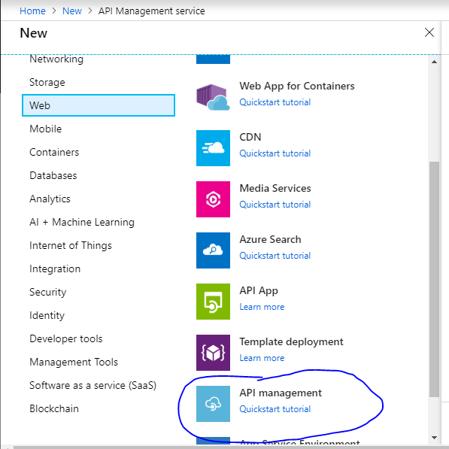

Slide 24
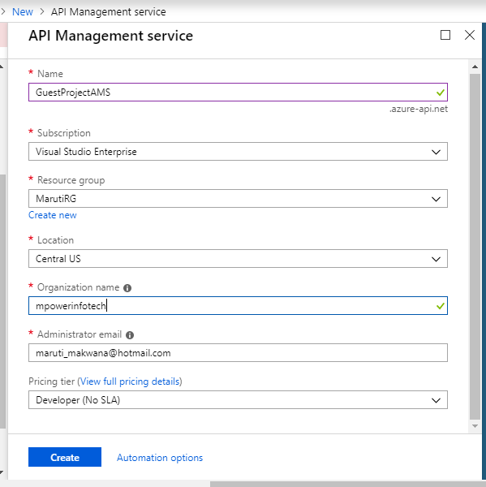
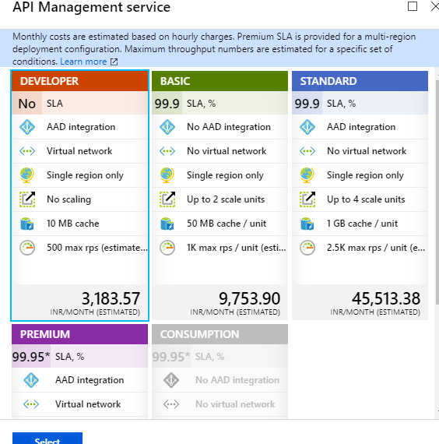

Slide 25
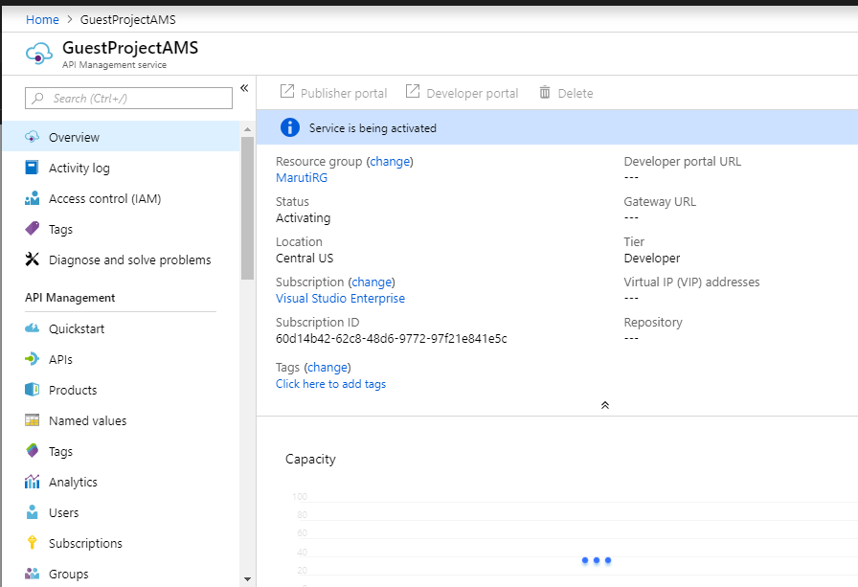
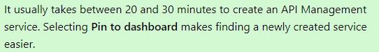

Slide 26
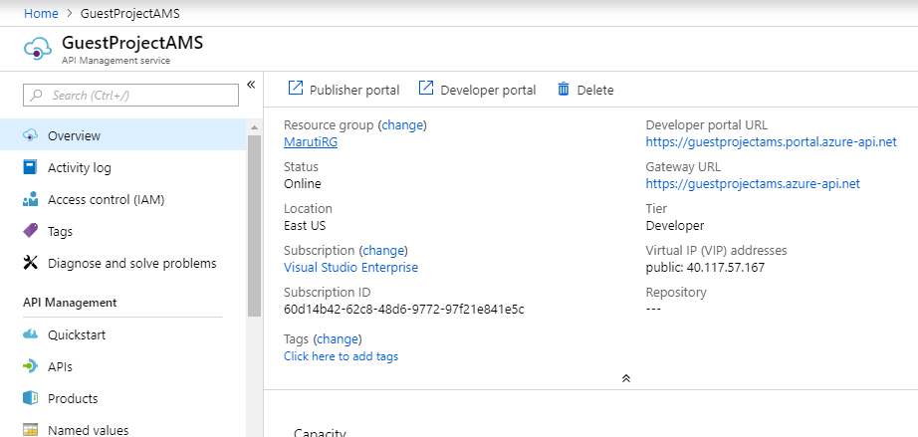

Slide 27
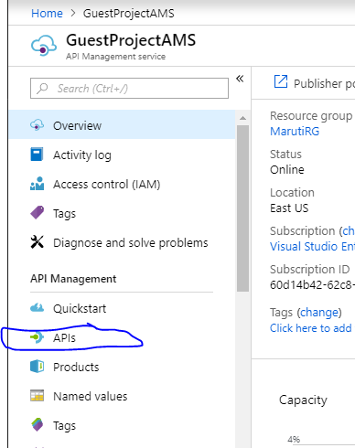

Slide 28
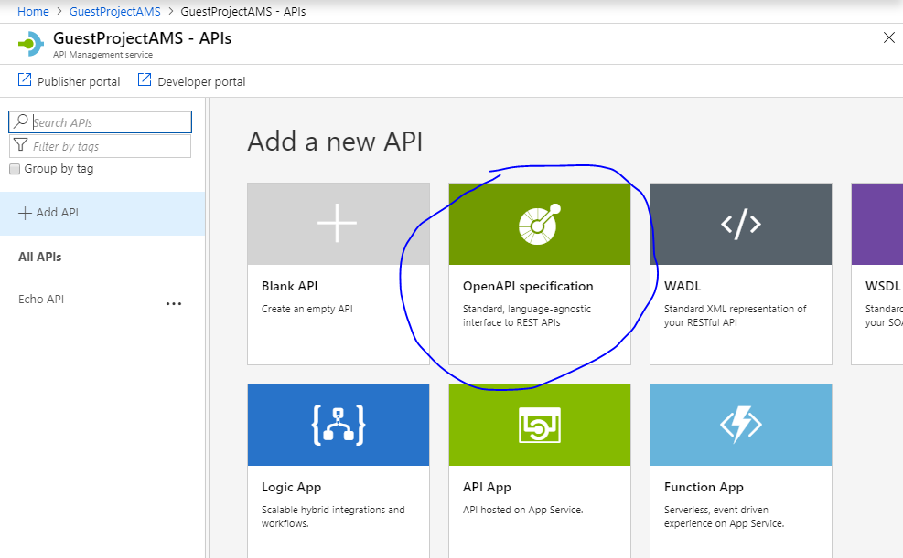

Slide 29
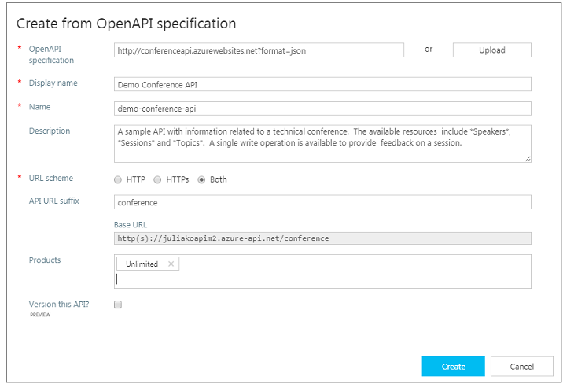

Slide 30
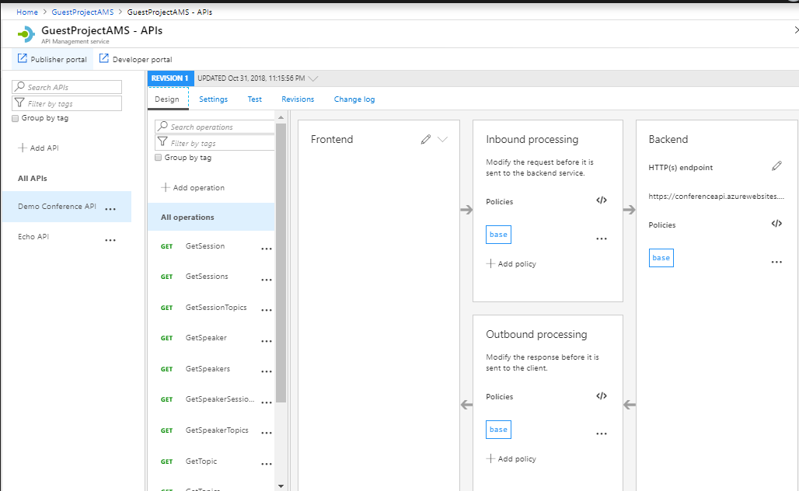

Slide 31
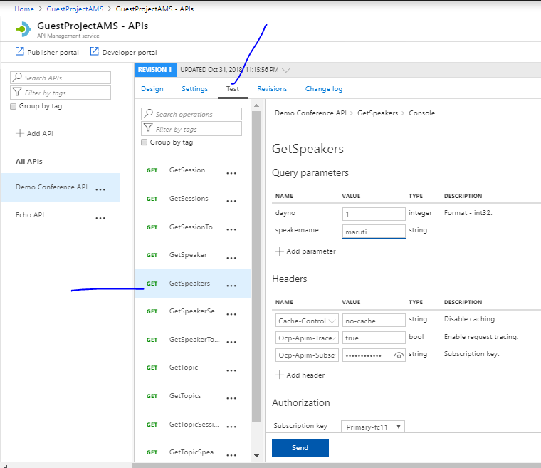

Slide 32
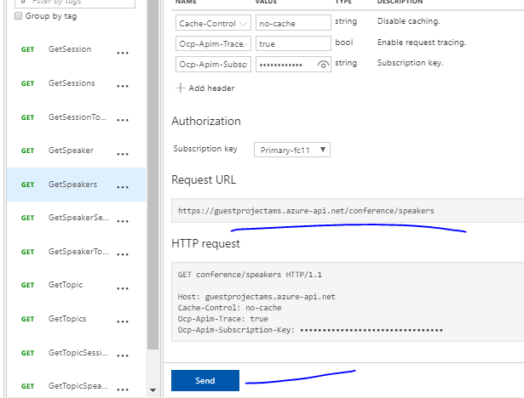

Slide 33
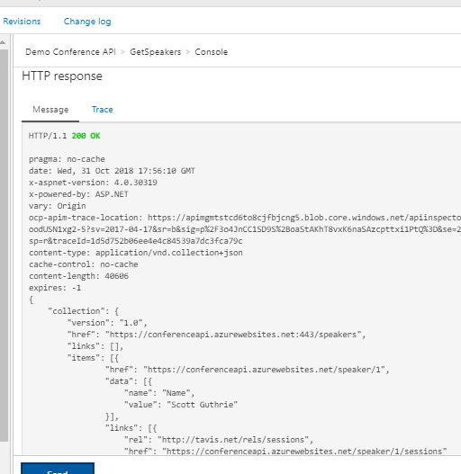
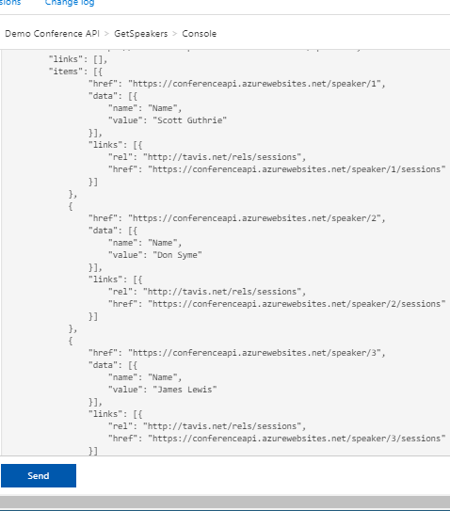

Slide 34
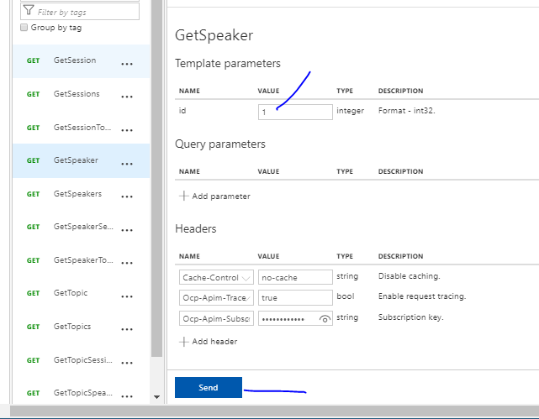

Slide 35
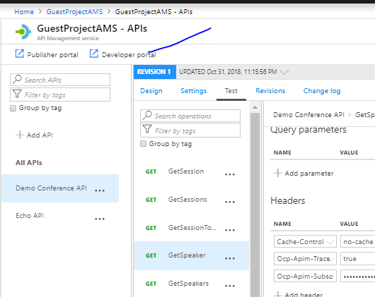

Slide 36
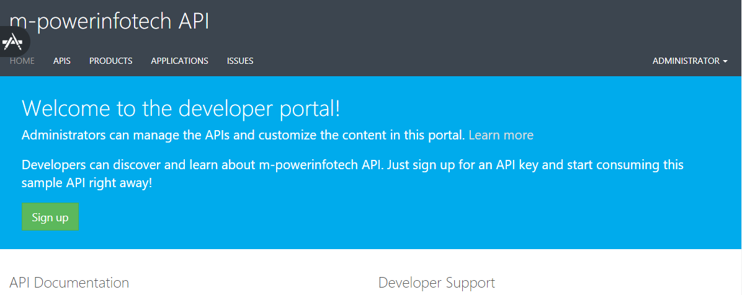

Slide 37
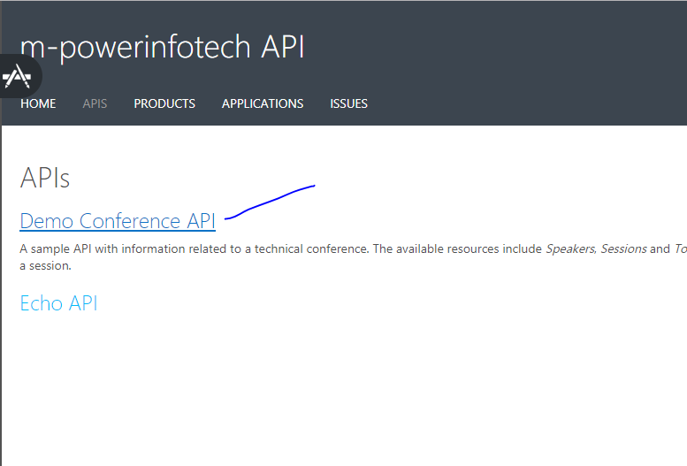

Slide 38
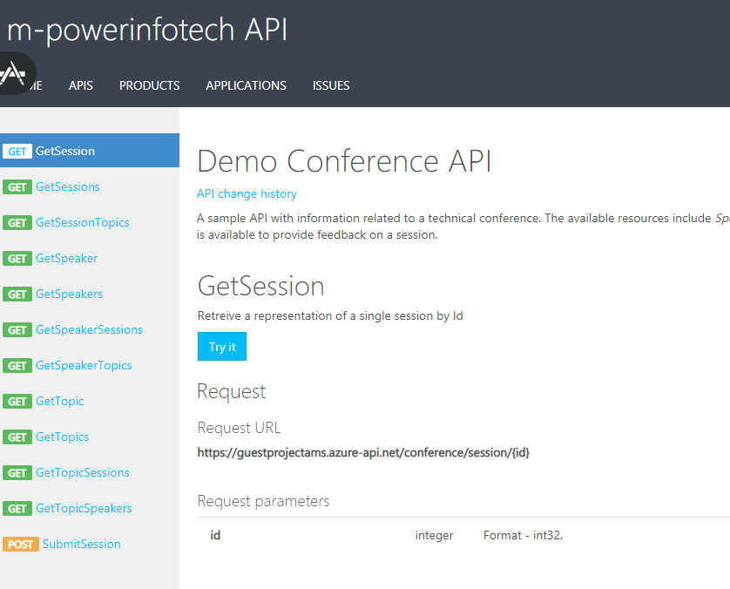

Slide 39
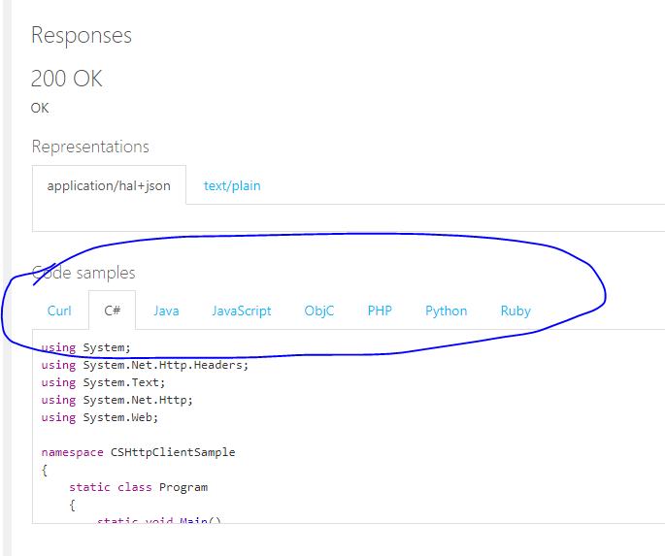
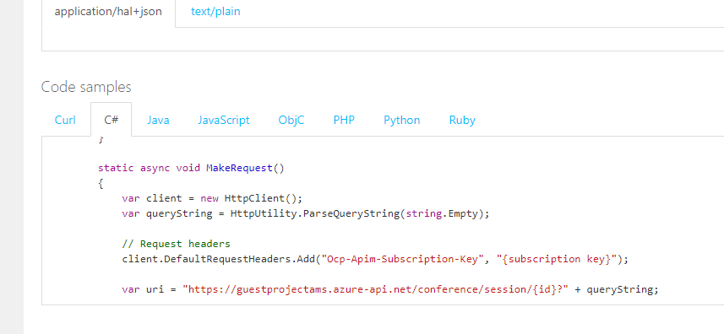

Slide 40
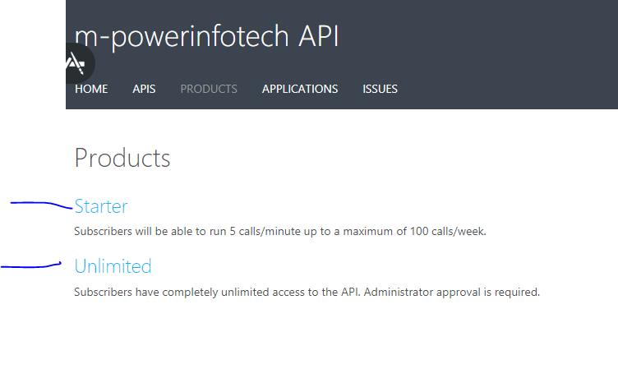

Slide 41
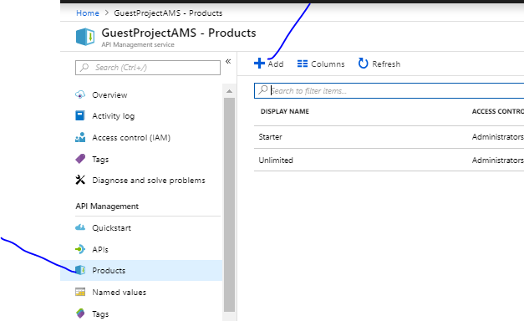

Slide 42
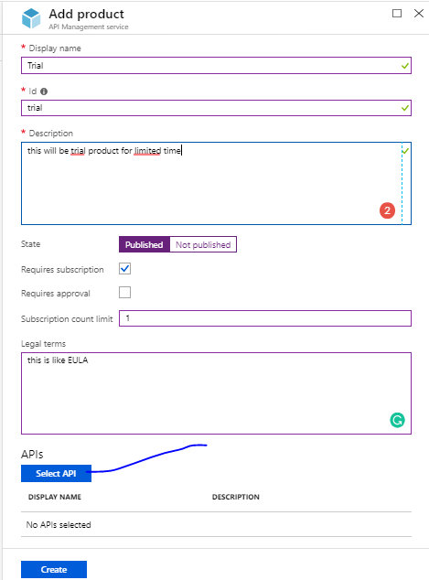

Slide 43
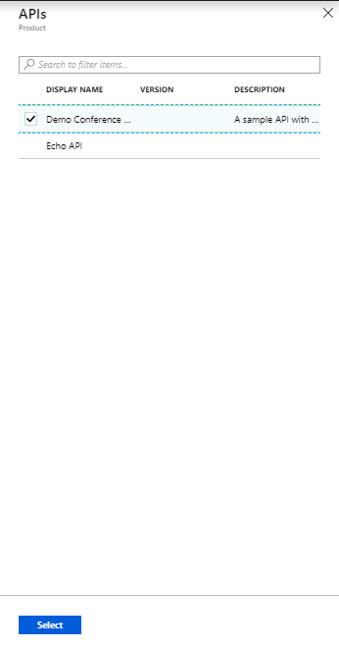

Slide 44
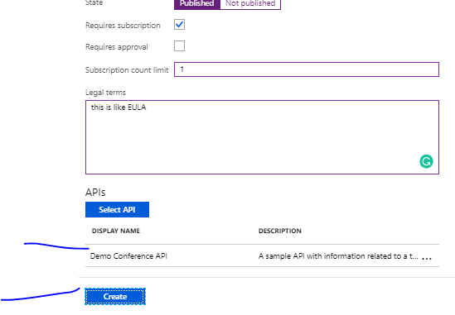

Slide 45
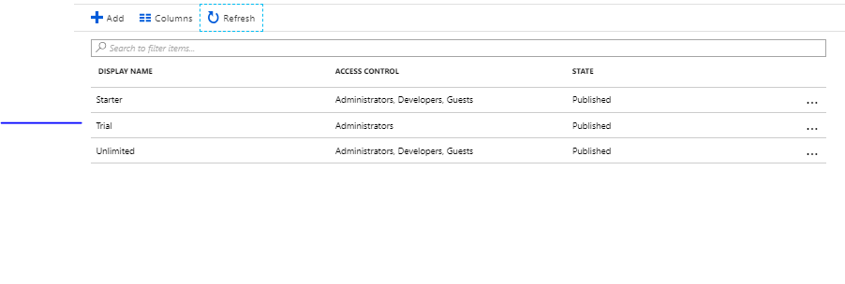

Slide 46
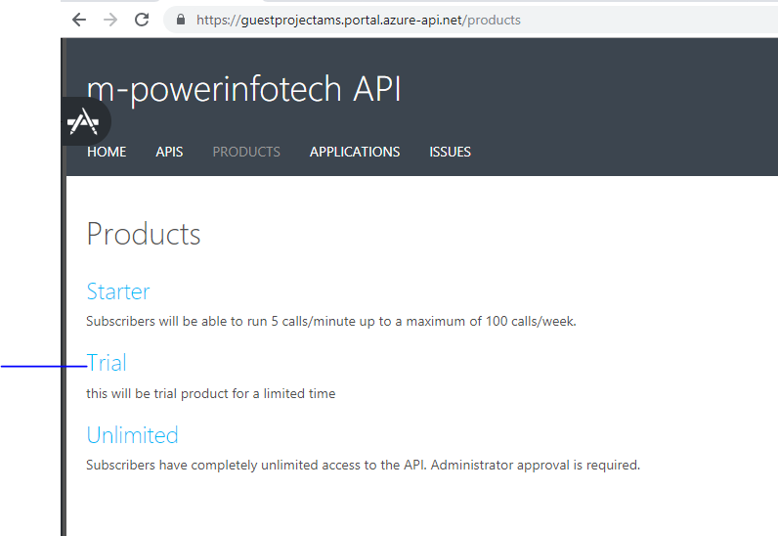

Slide 47
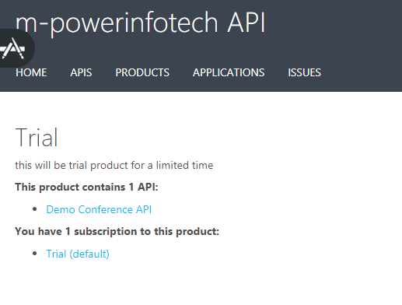

Slide 48
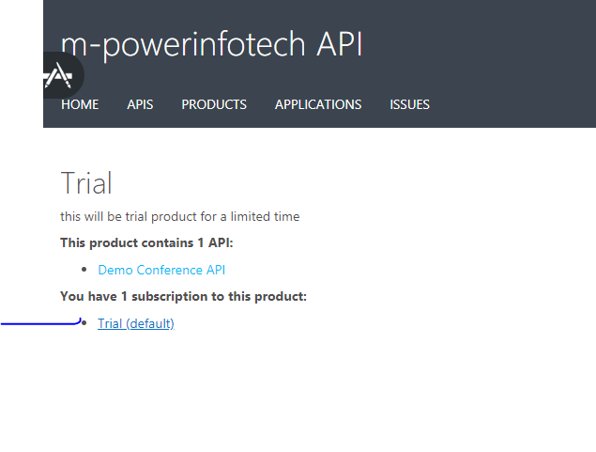

Slide 49
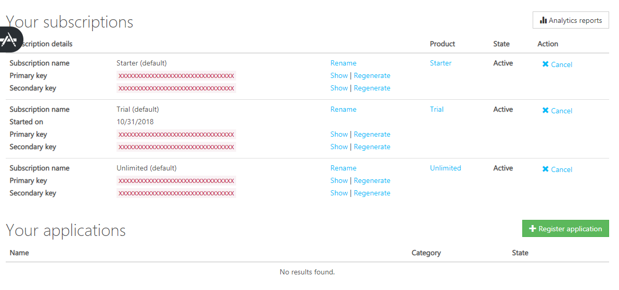

Slide 50
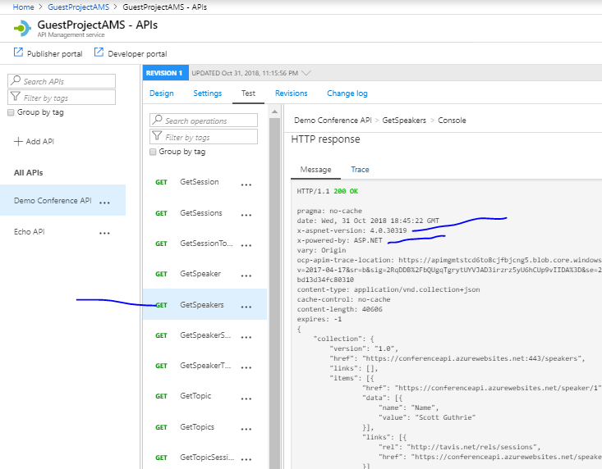

Slide 51
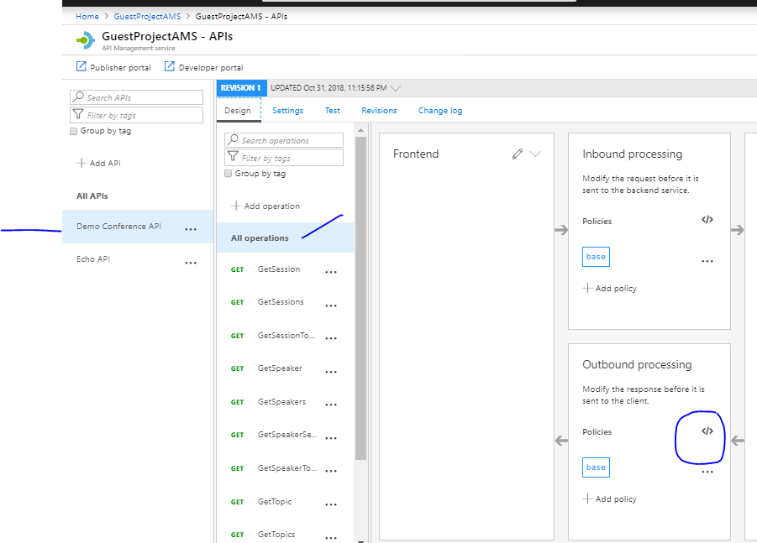

Slide 52
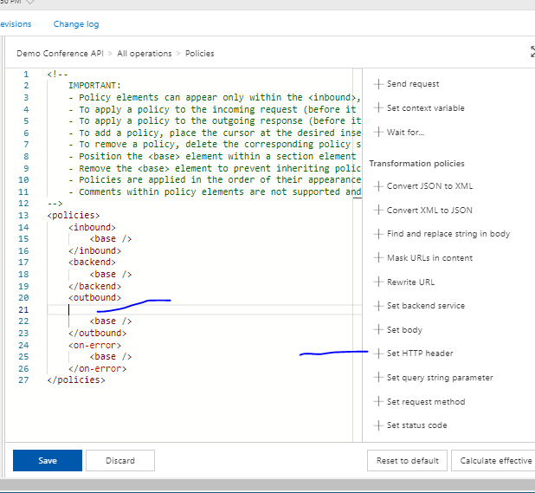

Slide 53
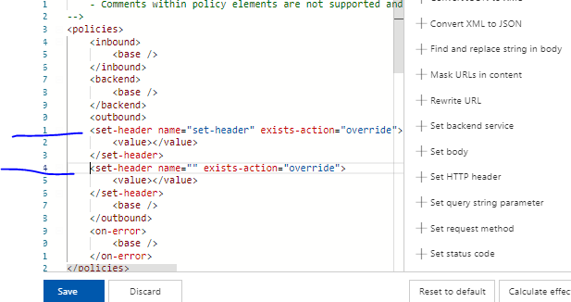
Click twice
And you will
Get 2 like this

Slide 54
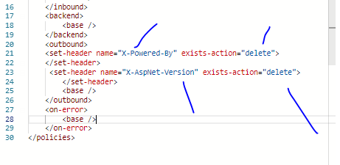
Remove value tag and save

Slide 55
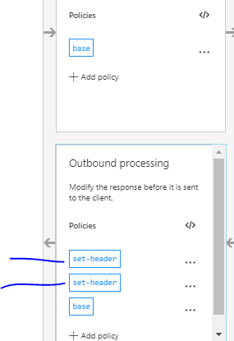

Slide 56
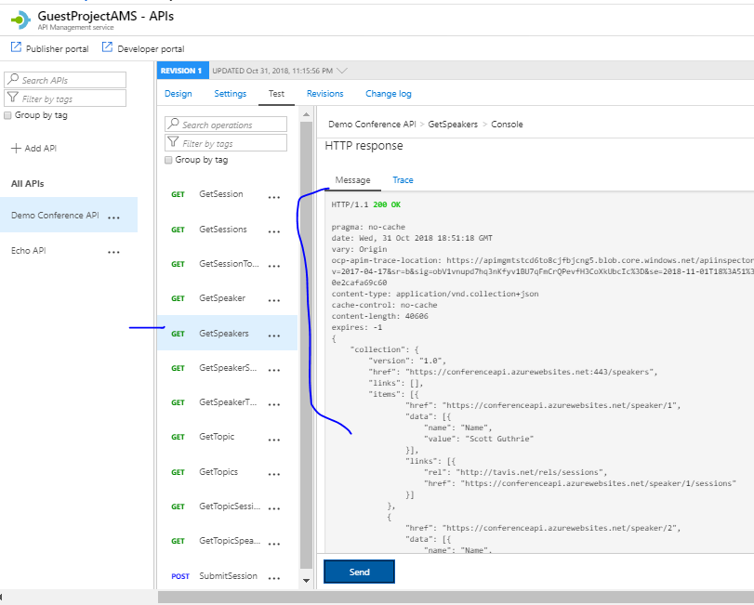

Slide 57
Protect an API by adding rate limit policy (throttling)
you may want to limit a number of calls the API is called so it is not overused by developers.
In this example, the limit is set to 3 calls per 15 seconds for each subscription Id. After 15 seconds, a developer can retry calling the API.

Slide 58
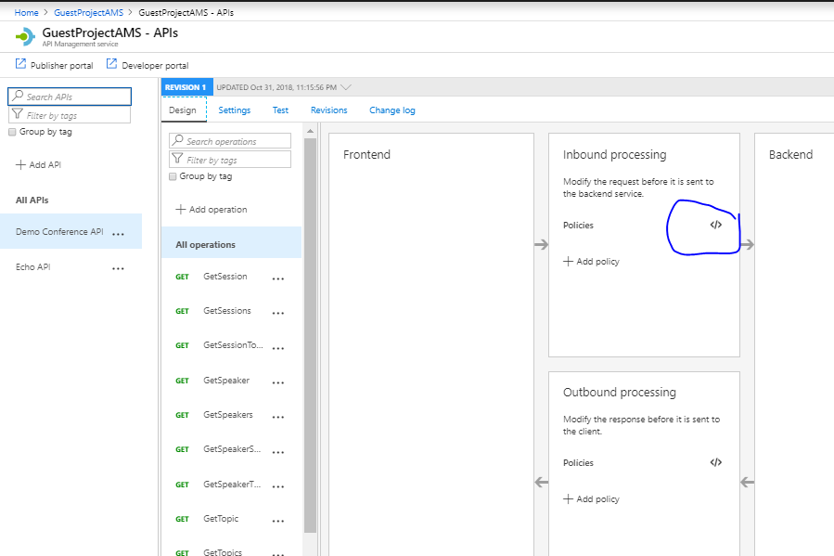

Slide 59
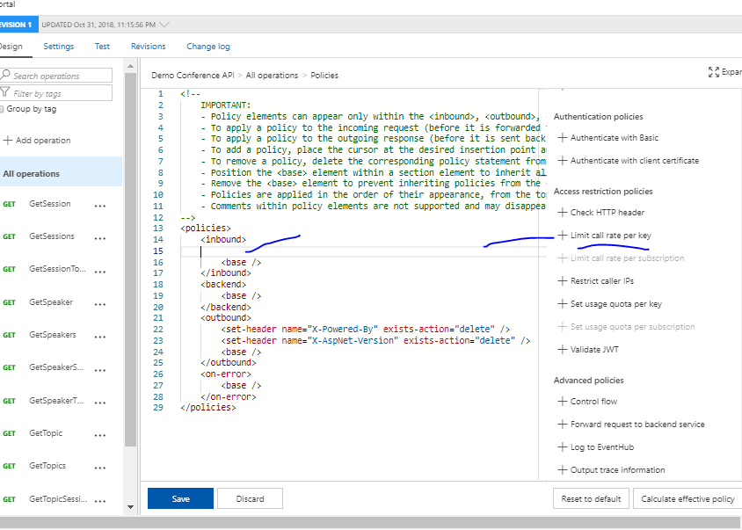

Slide 60
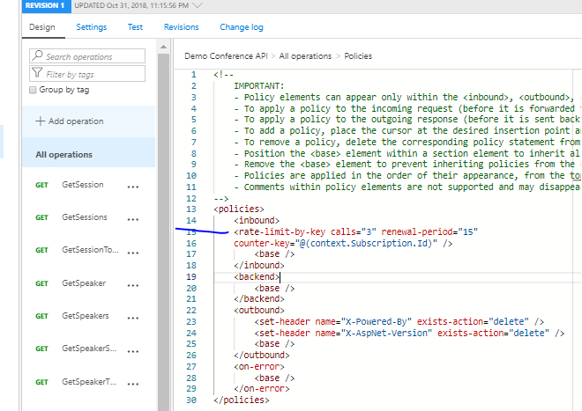

Slide 61
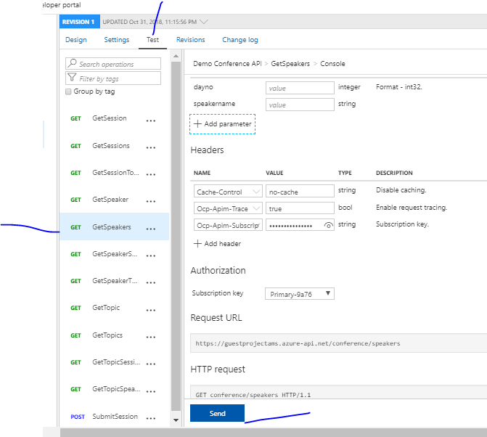
Send 3 times
quickly

Slide 62

At 4th time you will
Get this
Wait for some seconds
And again it will
Start showing

